Slide 1

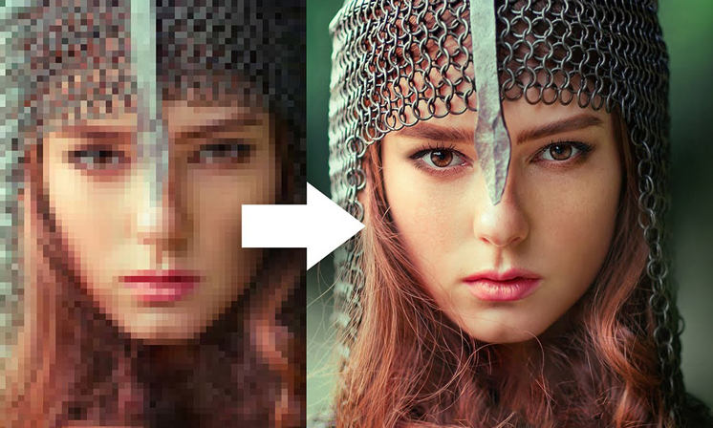
Image Enhancement with Super-Resolution and Controlled Noise
24-1-R-12
Students: Liza Shvachka
Avishai Hershkovitz
Supervisor: Dr. Renata Avros
Notes:
אבישי

Slide 2
Problem
Many Existing models of Image Enhancement rely on clean images for restoration, which are sometimes unavailable.
Real images are usually are influenced by many external not controlled factors.

Slide 3
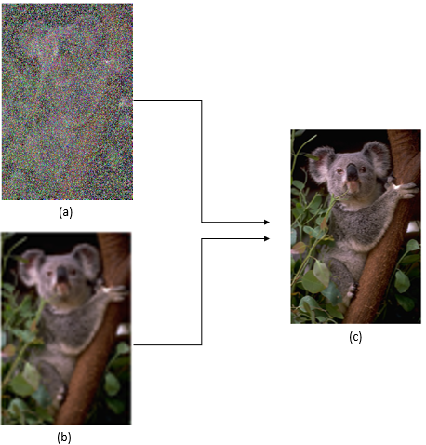
Suggested Solution
Enhance image quality by increasing resolution and removing noise based only on corrupted images.
Utilize Deep learning model Noise2Noise employing U-net.
Apply Super Resolution Deep learning model using RU-net.

Slide 4
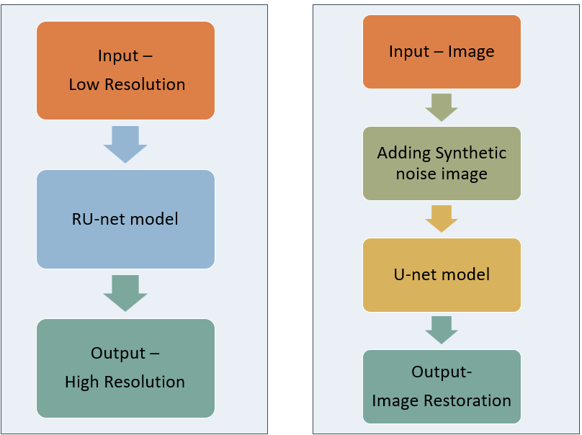
Super Resolution
Noise2Noise
Models

Slide 5
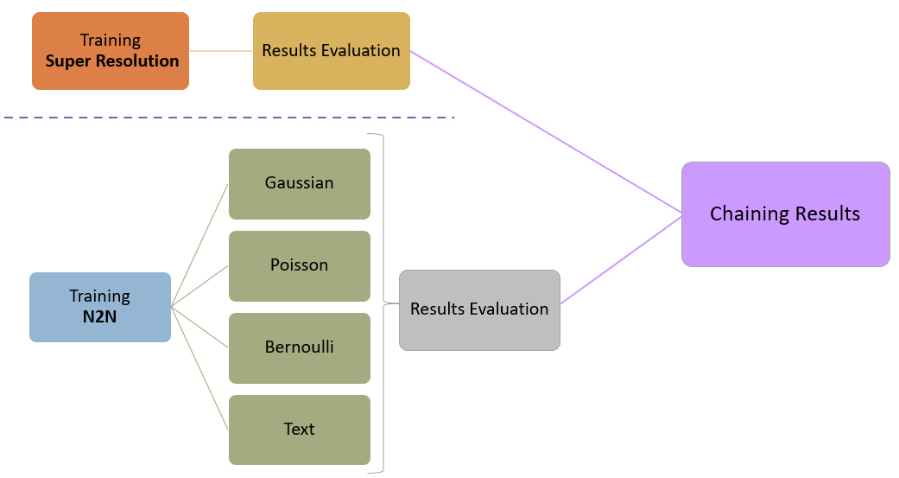

The Process
Notes:
Our process is divided into two parts. First the training of the super resolution model and the evaluation of the results, secondly the training of the noise model when we performed training for each type of noise separately. After we got the best results for both models we chained the results of the models in order to see the results.
Now we will present each model separately and the training results.

Slide 6
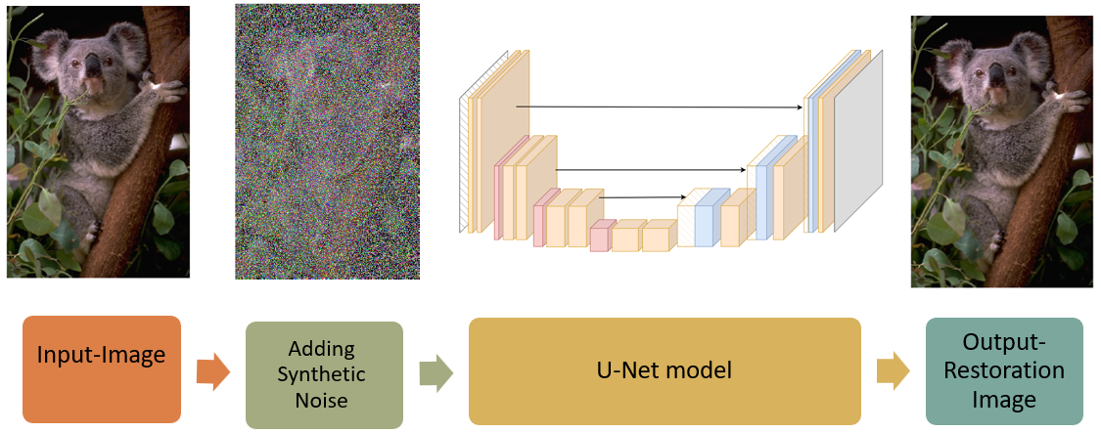
Noise2Noise- Train Process
Input: Image from various sources.
Adding Synthetic Noise: Simulating real-world conditions.
U-net Model Training: Iteratively mapping noisy to clean images.
Output: High-resolution image with minimized noise.
Notes:
The dataset contained diverse images from COCO. When the images were clean, i.e. without noise. Then for each type of noise we added it on the images for training.
We used a U-net model which was trained only on noisy images. Finally, we expected to get noise-free images, as similar as possible to the original images

Slide 7
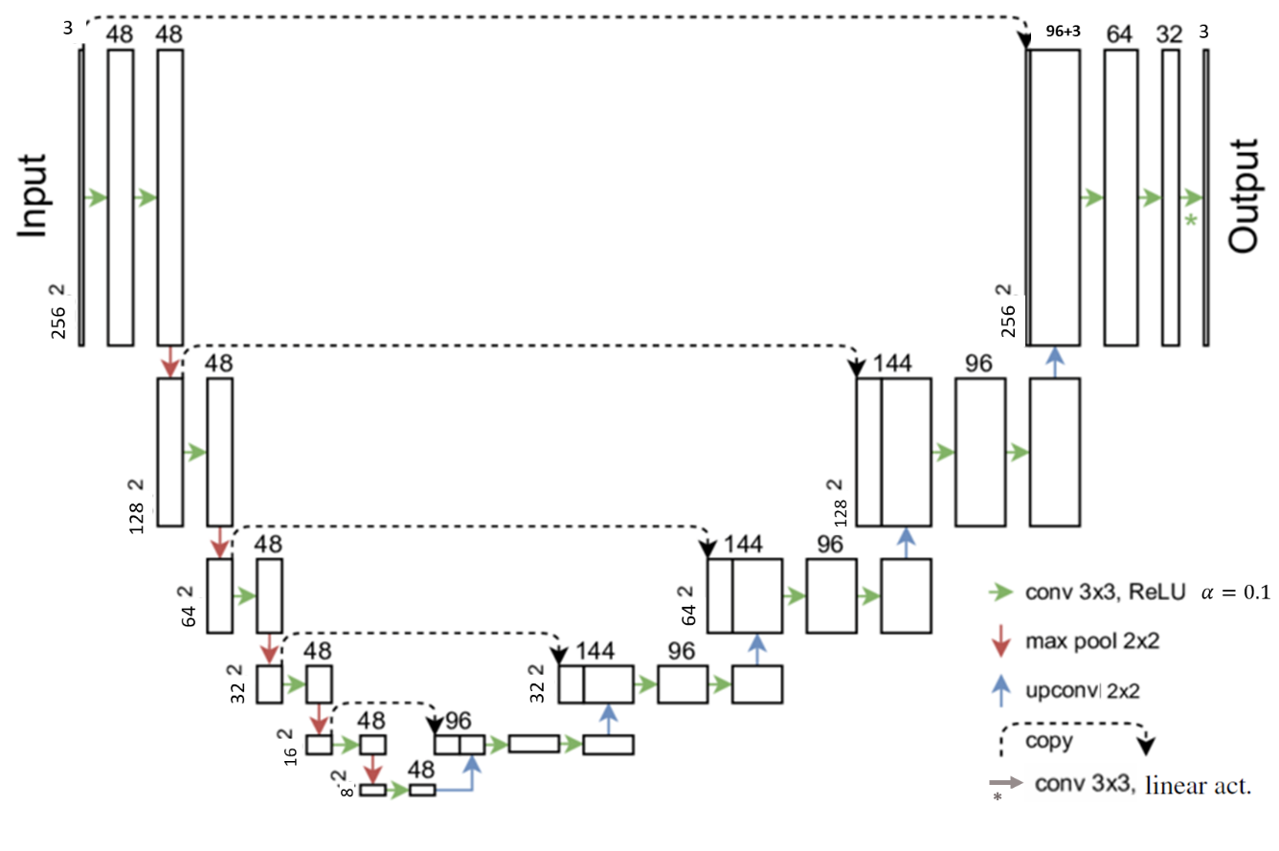
U-net architecture

Slide 8
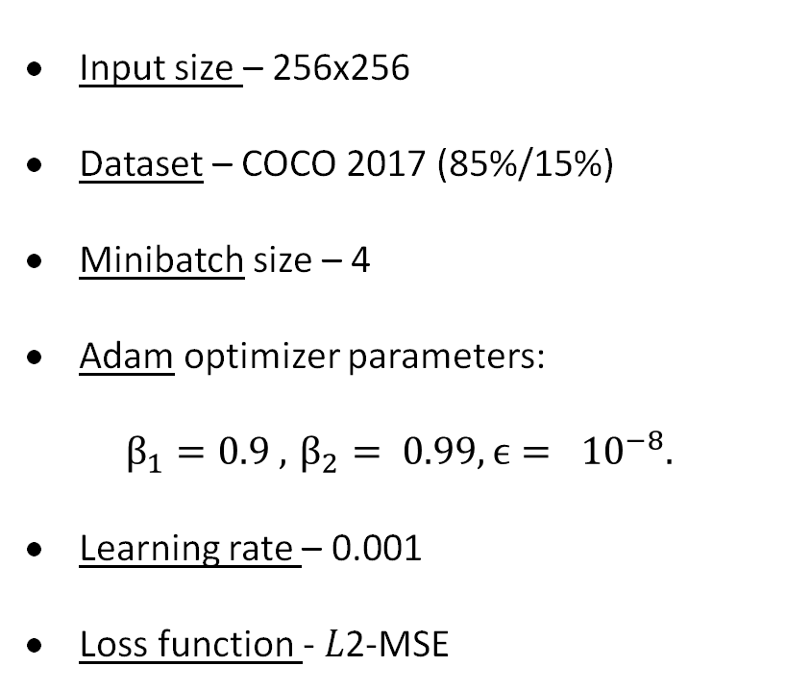
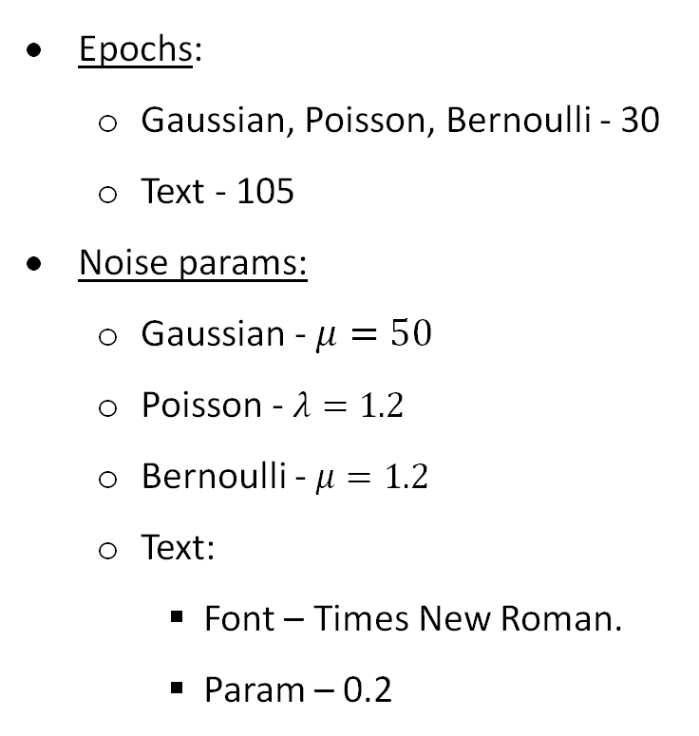
Hyperparameters
Input size – 256x256
Dataset – COCO 2017 (85%/15%)
Minibatch size – 4
Adam optimizer parameters:
$$β_{1}=0.9 , { β}_{2} = 0.99, ϵ= {10}^{−8}.$$
Learning rate – 0.001
Loss function - 𝐿2-MSE
Epochs:
Gaussian, Poisson, Bernoulli - 30
Text - 105
Noise params:
Gaussian - $μ=50$
Poisson - $λ=1.2$
Bernoulli - $μ=1.2$
Text:
Font – Times New Roman.
Param – 0.2
Notes:
During the research we changed some of the parameters until we got relatively good results.

Slide 9
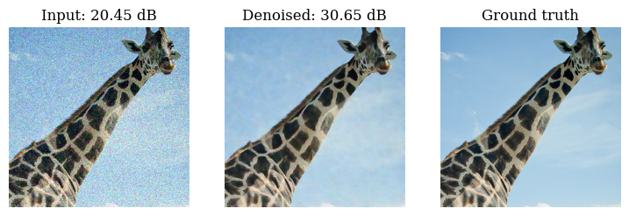
Examples Results- Gaussian noise
Noisy Image
Denoised Image
Clean Image
Notes:
PSNR- Peak Signal-to-Noise Ratio - measures the quality of a reconstructed image by comparing it to a reference image, focusing on the signal-to-noise ratio

Slide 10
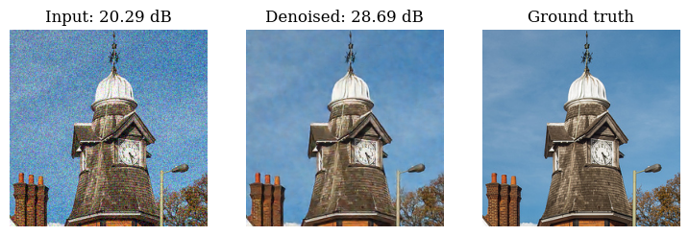
Examples Results-Gaussian noise
Noisy Image
Denoised Image
Clean Image

Slide 11
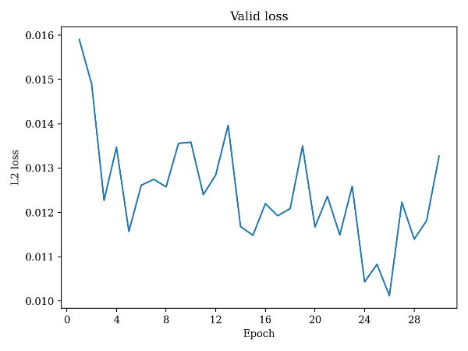
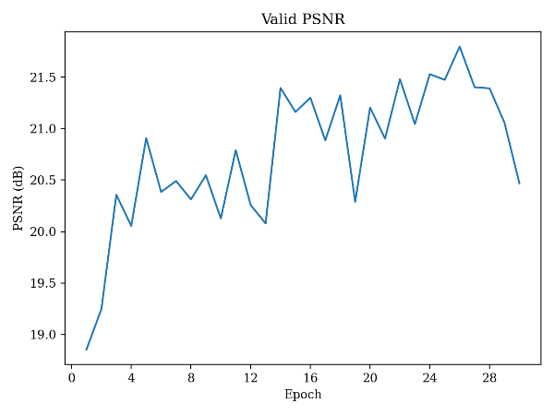
Metrics- Gaussian noise
Validation loss
Validation PSNR
Notes:
Learning rate changes causing overshooting.
Noisy batches affecting gradient updates.
Small batch size leading to higher variance in gradients.
Overfitting on specific batches with harder/noisier data.

Slide 12
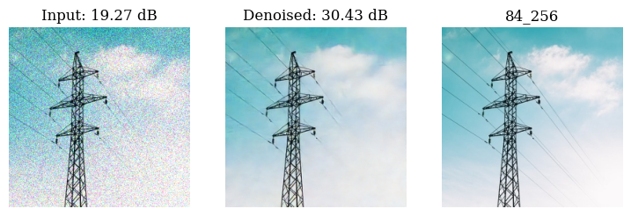
Examples Results- Poisson noise
Noisy Image
Denoised Image
Clean Image

Slide 13
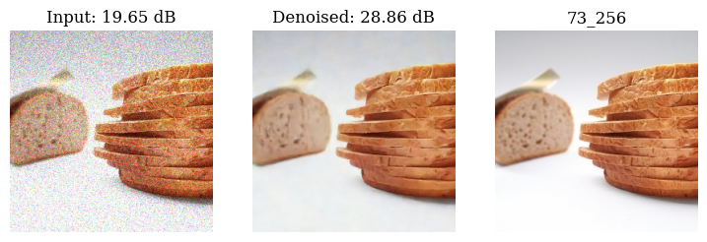
Examples Results- Poisson noise
Noisy Image
Denoised Image
Clean Image

Slide 14
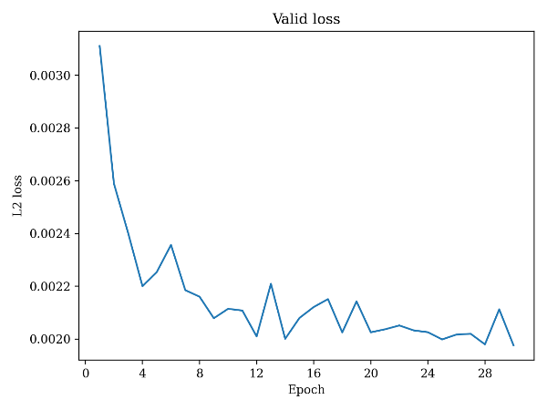
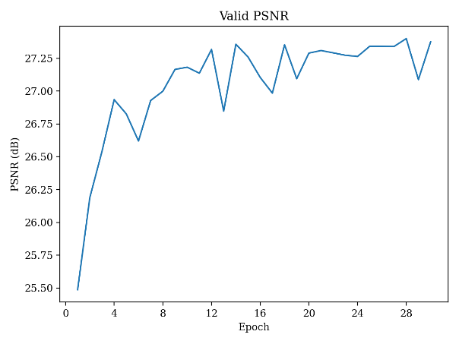
Metrics- Poission Noise
Validation loss
Validation PSNR
Notes:
Here you can see that the model is more stable

Slide 15
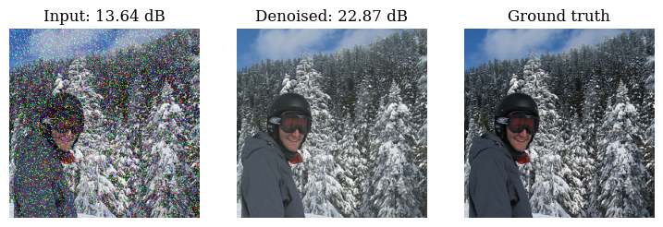
Examples Results- Bernoulli noise
Noisy Image
Denoised Image
Clean Image

Slide 16
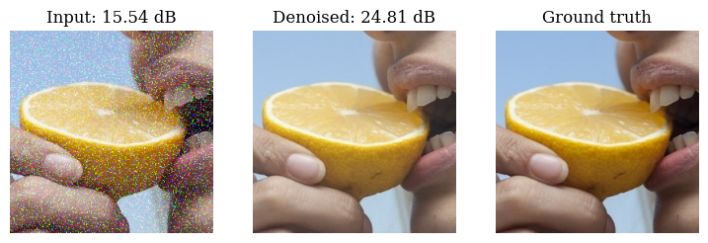
Examples Results- Bernoulli noise
Noisy Image
Denoised Image
Clean Image

Slide 17
Metrics- Bernoulli Noise
Validation loss
Validation PSNR

Slide 18
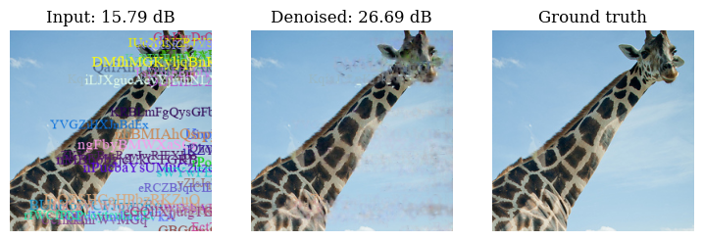
Examples Results- Text Overlay
Noisy Image
Denoised Image
Clean Image

Slide 19
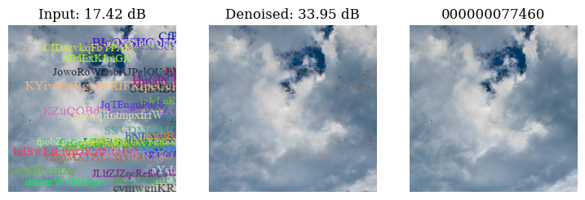
Examples Results- Text Overlay
Noisy Image
Denoised Image
Clean Image

Slide 20
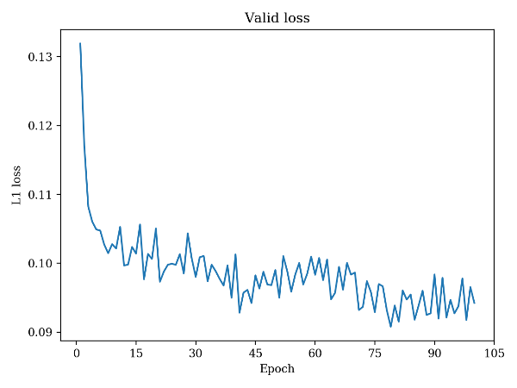
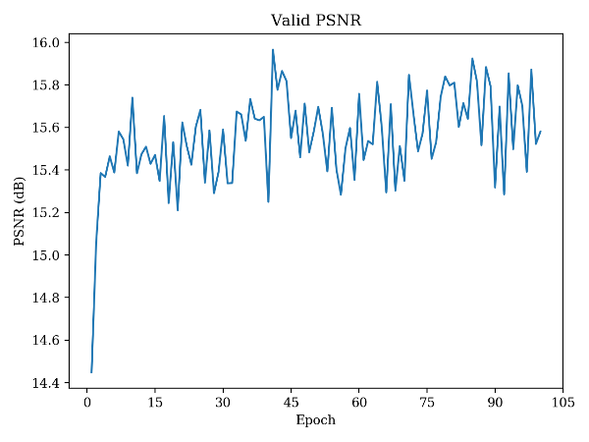
Metrics- Text Overlay
Validation loss
Validation PSNR

Slide 21
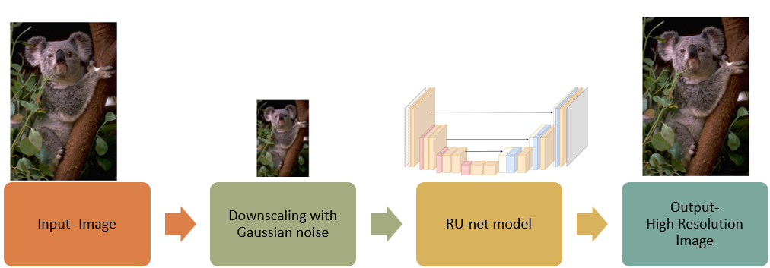
Super Resolution- Train Process
Input: High-resolution images.
Synthetic Low-Resolution: down-sampled, blurred, up-sampled.
RU-net Model Training: A robust U-net architecture.
Output: High-resolution images and visual enhancement.

Slide 22
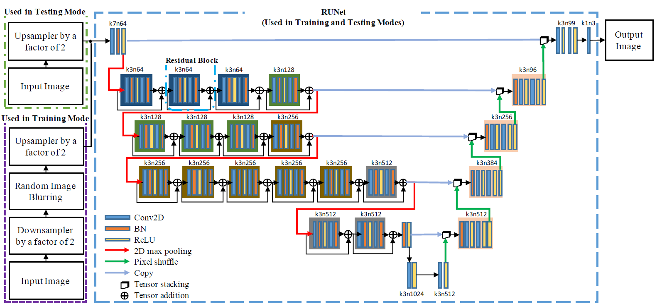
RU-net architecture

Slide 23
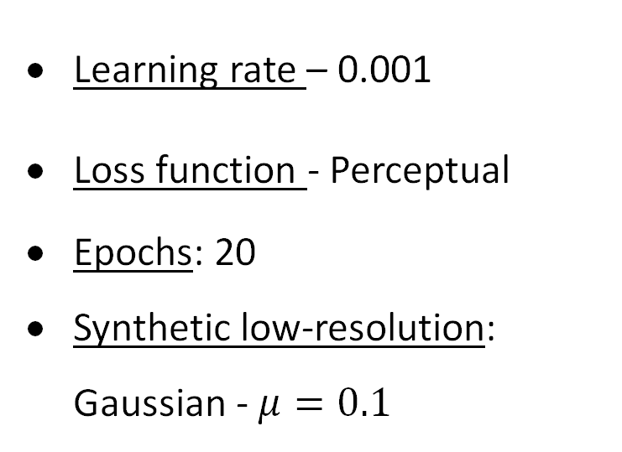
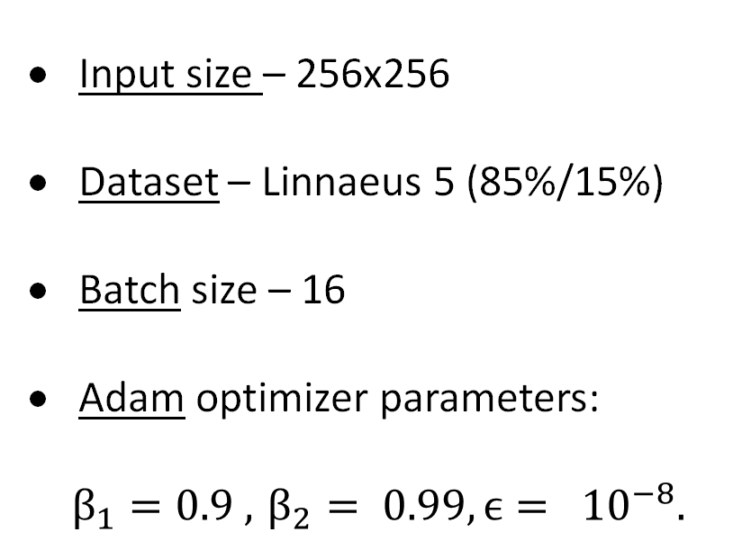
Hyperparameters
Input size – 256x256
Dataset – Linnaeus 5 (85%/15%)
Batch size – 16
Adam optimizer parameters:
$$β_{1}=0.9 , { β}_{2} = 0.99, ϵ= {10}^{−8}.$$
Learning rate – 0.001
Loss function - Perceptual
Epochs: 20
Synthetic low-resolution:
Gaussian - $μ=0.1$

Slide 24
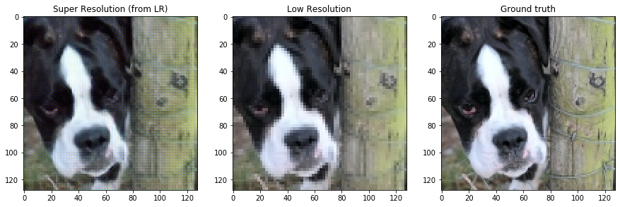
Examples Result
Super Resolution
Low Resolution
Ground truth

Slide 25
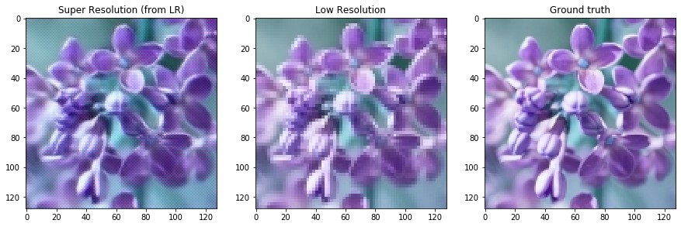
Examples Result
Super Resolution
Low Resolution
Ground truth

Slide 26
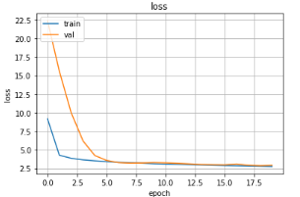
Metrics- Super Resolution
Validation loss
Notes:
אבישי

Slide 27
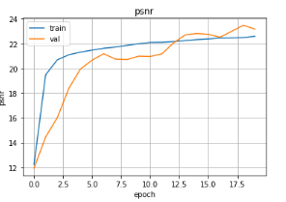
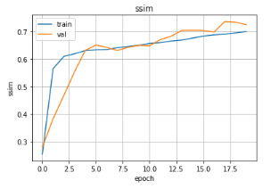
Metrics- Super Resolution
Validation PSNR
Validation SSIM
Notes:
אבישי

Slide 28
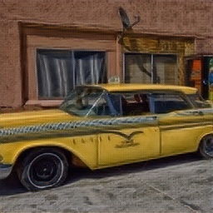
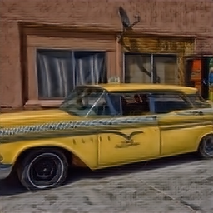
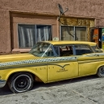
Result Chaining
Combining models' results, the first model's output serves as the second model's input
Clean Low Resolution
High Resolution
N2N- Poisson
Notes:
There doesn't seem to be much improvement in the image; only a few parts look softer/more refined.

Slide 29
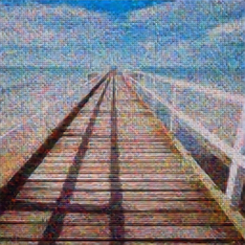
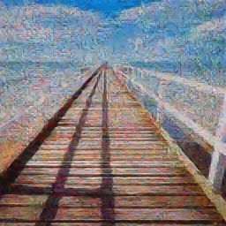
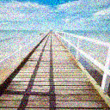
Result Chaining
Combining models' results, the first model's output serves as the second model's input
Noisy Low Resolution
High Resolution
N2N- Gaussian
Notes:
Even in this case, there is no significant improvement, only in isolated and small areas

Slide 30

The Product

Slide 31

Expected Achievements
Improve Super-resolution.
Clean corrupted image techniques without explicit data.
Integrating both models results.
Notes:
In the first part we placed achievements for the project. We implemented a model that knows how to increase the resolution of an image, as well as a model that reproduces an image and removes the noise from it based only on noisy images. And we combined the results of the models in order to evaluate the results.
Regarding the combination, it is possible to further combine the models already in the training phase.

Slide 32
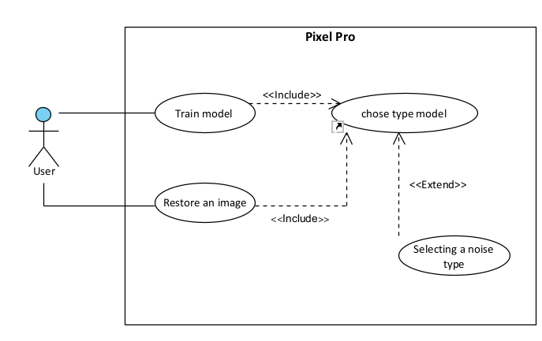
Use Case

Slide 33
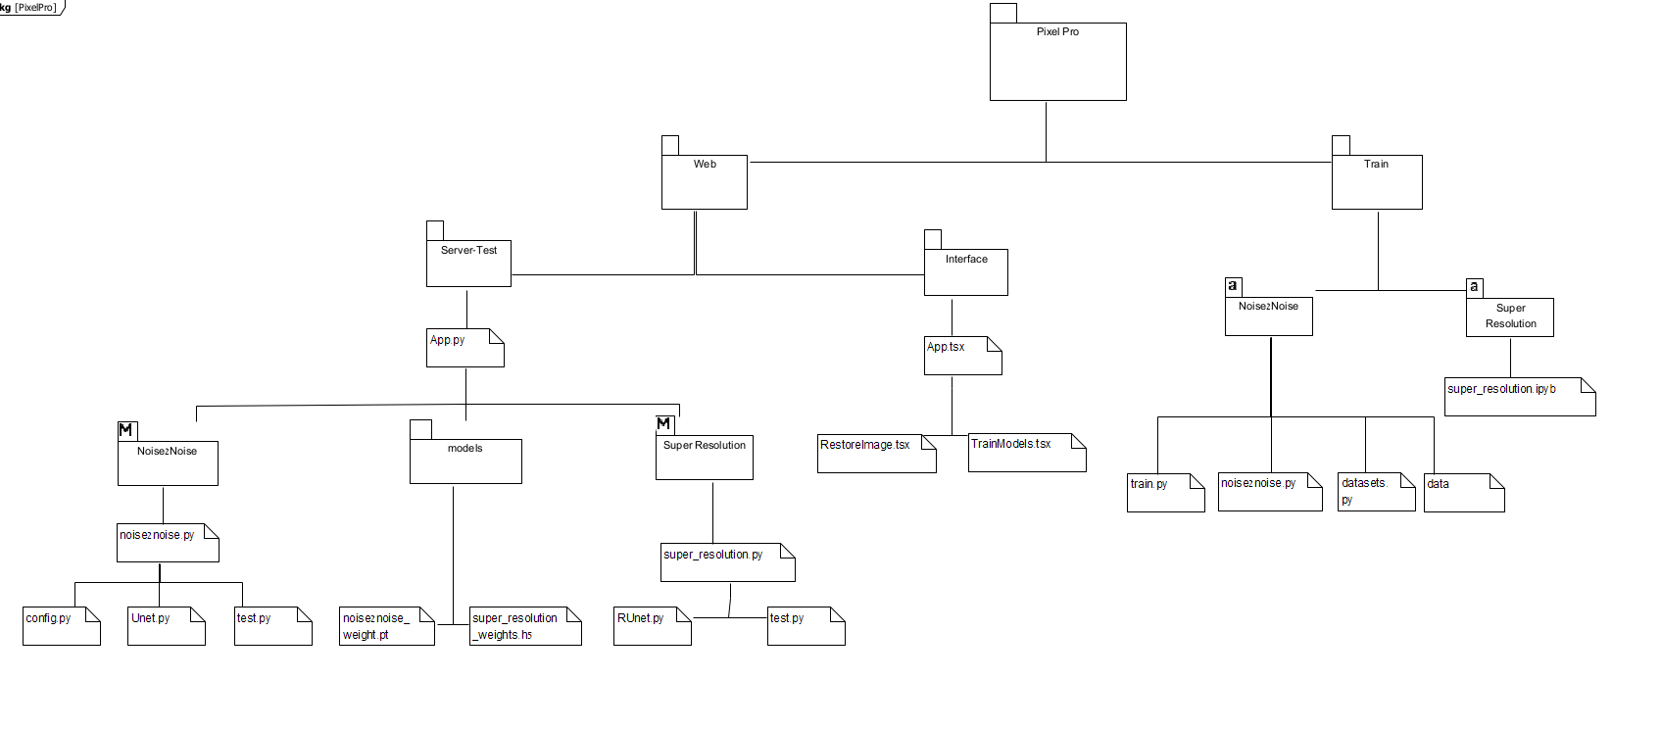
Package

Slide 34
Test process
Excepted result | Test description | Module
Open 'Train Models' window | Click 'Train Models' in sidebar menu | Home page
Open 'Restore an image' window | Click 'Restore an image' button in sidebar menu | Home page
Open 'Upload dataset' window | Click 'Upload dataset' button in sidebar menu | Home page
Option ‘Super resolution' should be chosen. | Click on combo box 'Type of model' and choose 'Super resolution' | Train Models window>Type of Model
Option ‘Gaussian' should be chosen | Click on combo box 'Type of noise' and choose 'Gaussian' | Train Models window ->Type of model (Noise2Noise)->Type of noise
Option ‘Poisson' should be chosen | Click on combo box 'Type of noise' and choose 'Poisson' | Train Models window ->Type of model (Noise2Noise)->Type of noise
An alert in red will pop up with message 'one or more fields are not chosen' | Click on 'Train' button (failure case: One or more combo box not chosen) | Train Models window
Open the file explorer to select the files | Click on ‘Browse for file' | Restore an image window->Upload image
Advance to step of Clear image processing with active precent of the clear | Click on button 'Start process' | Restore an image window->Clear image
Download the clean image to your computer | Click on button 'download' | Restore an image window->Finish process

Slide 35

Thanks for your attention!
Liza Shvachka
Avishai Hershkovitz

